Slide 1
Unit 5 Text B
Your Life Is Tetris

Slide 2
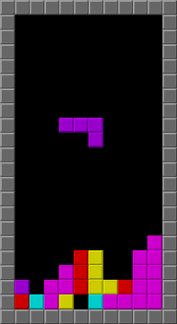
Tetris

Slide 3
in school
before 15 years old
play chess frequently and competitively
where
online
at national competitions
Introduction
(para.1)
addicted
kill
boredom
became to Tetris
after 15 years old
access
 the internet
played Tetris with a small flip phone
send a
Snapchat

Slide 4
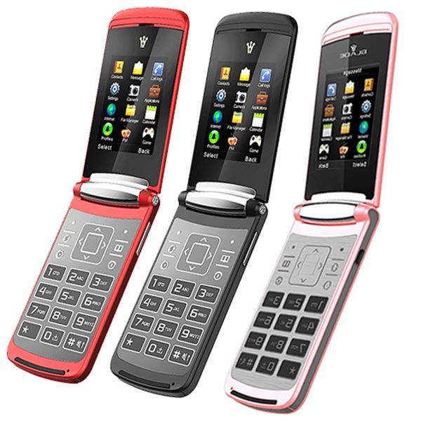
Snapchat
flip phone

Slide 5
people to fight
looking for
people to blame
grew up opponents
people to prove wrong
before playing Tetris
(para.3)
treated everything like it was
zero-sum
disbenefit
hold you back when there was so much else to gain

Slide 6
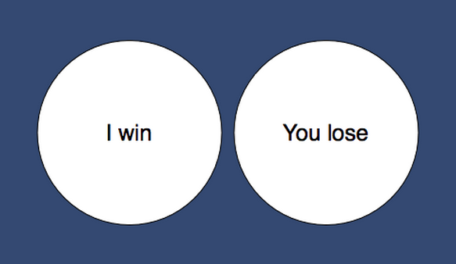
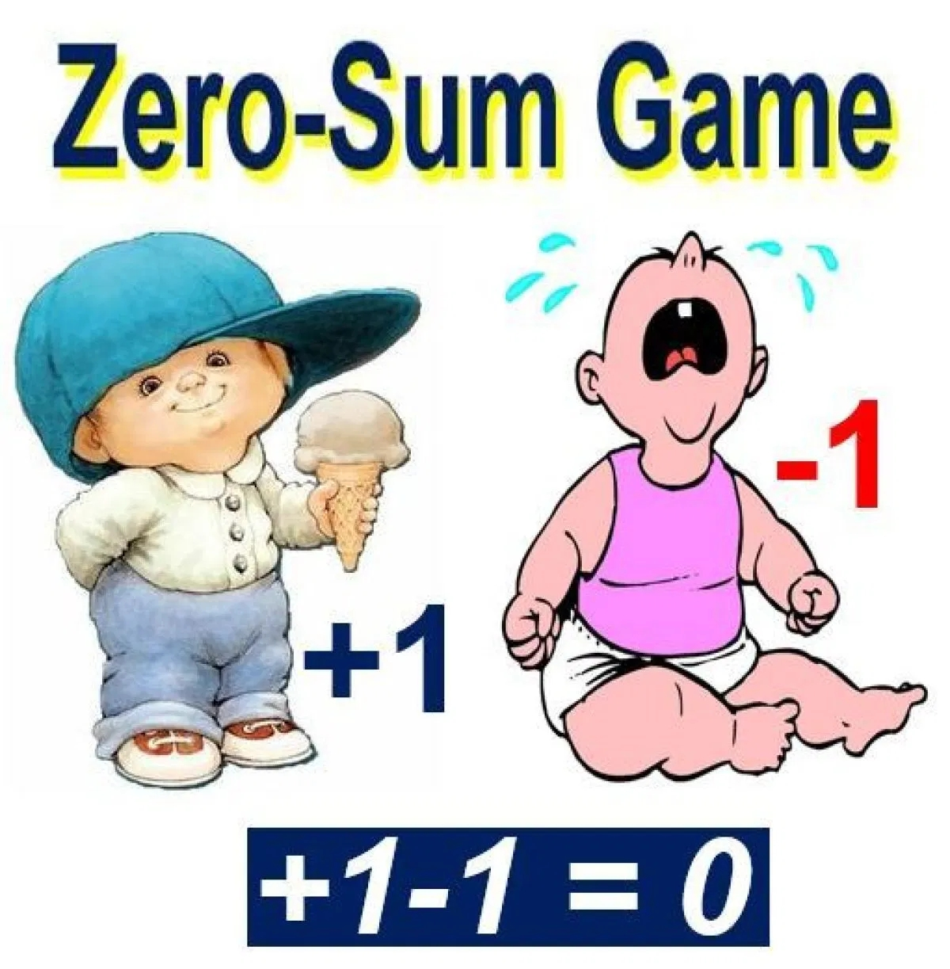
Zero-sum

Slide 7
representation
became the truest of life
to the author
Tetris
Life is , not chess.
after playing Tetris
There’s no final boss.
only playing against
understanding of Tetris and life
The never ending flow of pieces from .
time
top to bottom
(para.2,4)
random
operate a stream of into an form
inputs
orderly
frustration
impossible to win
. in human form
to some people
driven by luck

Slide 8
after playing Tetris
no big ,bad enemies who make you suffer
understanding of Tetris and life
The real game of life is completely .
no right or wrong move that a certain opponent can punish
absolute
internal
(para.5)
life score depending on how hard you push yourself

Slide 9
after playing Tetris
understanding of Tetris and life
the only way to master life
(para.6)
play with
. the same self-control at the highest speeds
control your own mind
control your own behaviours
control your own time

Slide 10
after playing Tetris
understanding of Tetris and life
differences
realize the of playing chess and Tetris
(para.7)
Tetris
only know what the next is
chess
piece
system
an open system
a closed .
play for the present moment
see twenty moves into the future
impossible
to the situation
predict

Slide 11
C
1 The author stopped playing chess when he ____________.
A. was seven B. was eleven C. got a cell phone D. got a computer
2 Which of the following games were still on the author’s phone?
A. Chess. B. Tetris. C. Snapchat. D. All of the above.
3 In Tetris, you have ____________ opponent(s).
A. one B. two C. three D. no
B
D

Slide 12
A
4 According to the author, Tetris and life are similar because_________.
A. they are for the present and you cannot control the future
B. they are for the future and you can predict what will happen in the future
C. they are complicated in nature and we should do nothing
D. Tetris can be treated as the real life we have
5 According to the text, which one is correct?
A. The author’s attitude towards Tetris is negative.
B. The author’s attitude towards Tetris is positive.
C. The author likes to play Tetris and chess sometimes.
D. The author gave up gaming when he was fifteen years old.
B

Slide 13
Text B Extensive Reading
Your Life is Tetris
New Words
1 chess /tʃes/ n. 国际象棋
2 national /'næʃnəl/ adj. 国际的，民族的
3 flip /flɪp/ n. 翻转
4 access /'ækses/ v. 使用，进入
5 boredom /'bɔːdəm/ n. 厌烦，无聊
6 addicted /ə'dɪktɪd/ adj. 上瘾的
7 frustration /frʌ'streɪʃn/ n. 懊恼，沮丧
8 representation /ˌreprɪzen'teɪʃn/ n. 表现，描述，描绘
9 constant /'kɒnstənt/ adj. 持续的，永恒的
10 opponent /ə'pəʊnənt/ n. 对手，竞争者

Slide 14
11 random /'rændəm/ adj. 任意的，随机的
12 input /'ɪnpʊt/ n. 输入，投入（此处指游戏中随机出现的方块组合）
13 orderly /'ɔːdəli/ adj. 整洁的，有秩序的
14 internal /ɪn'tɜːnl/ adj. 内部的，内在的
15 suffer /'sʌfə(r)/ v. 受难，受折磨
16 absolute /'æbsəluːt/ adj. 完全的，全部的
17 infinity /ɪn'fɪnəti/ n. 无限，无穷
18 causal /'kɔːzl/ adj. 具有因果关系的，原因的
19 system /'sɪstəm/ n. 系统，体系，体制
20 predict /prɪ'dɪkt/ v. 预言，预报，预告

Slide 15
1 be impossible to do sth. 不可能做某事
2 be driven by… 被……驱使
3 look for 寻找
4 hold back 控制，阻碍，犹豫不决
5 from top to bottom 从头到尾
6 play with… 和……玩

Slide 16
Language focus
matching exercises
任意的，随机的
access
通道，途径，机会
boredom
厌烦，厌倦
addicted
random
体内的，内部的
internal
入迷的，上瘾的
□predict
预言，预料

Slide 17
access
boredom
addicted
random
internal
predict
random
 We asked a sample of people what they thought.
access
 The only to the village is by boat.
addicted
● By the age of 14 he was to heroin.
predict
❍ No one can when the disease will strike again.
internal
■ The government warned its neighbours not to interfere in its affairs.
boredom
□They started quarrelling out of sheer .

Slide 18
Language focus
matching exercises
be impossible to do sth.
控制，阻碍
be driven by…
不可能做某事
look for
被……驱使
hold back
从头到尾
from top to bottom
寻找
□play with…
和…玩

Slide 19
be impossible to do sth.
be driven by
look for
hold back
from top to bottom
play with
from top to bottom
 They cleaned the house .
hold back
 No one can the wheel of history.
be driven by
So our next milestones will the requirements we get.
looking for
I'm my passport.
was impossible to
■ It sleep because of the noise.
play with
□ When I was a kid ,I liked to my younger sister .

