Slide 1
A Story About Coins

Slide 2
Learning Objectives
To scan for specific information to understand the main idea
To understand some words and phrases: propose, exchange, involve, show off, no longer…
To raise awareness of money management

Slide 3
Teaching procedures
Structure Analysis
Reading Comprehension
Language Focus
Theme Exploration
4
Lead-in
Checklist
Assignment
5

Slide 4
Lead-in
Let’s say you have an extra million dollars lying around and you decide you want to finance a new car. The car payments average out to be about $800 per month.
What will you do here?
Those with a mindset for wealth, who view money as a tool, might do something as simple as this: Place the million dollars in a savings account that yields a 1% return and then use the $833 per month accumulated interest to pay for the car.

Slide 5
Lead-in
money management

Slide 6
Fast Reading
Read para.1 & para.2, and answer questions.
1. What is Julia and her cousins’ exciting moment at their grandparents’ house?
2. Why do the relatives propose a test among the children?
The moment their grandfather gives them a few coins.
They want to know what the children could do to manage those coins.
Notes:
What does working mean here?
working means functioning/ operating. Canada’s far north rely a lot on what ice road truckers transport.

Slide 7
Structure Analysis
Part Ⅰ
(para. 1-2)
problem
The kids never learn to manage money.
Part Ⅱ
(para. 3-8)
Part Ⅲ
(para. 9)

Slide 8
Reading Comprehension
Ruben and Nico continue spending all their coins on sweets and their sweets ,making Clara and Joe could keep saving their money.
show off
Para. 3
no longer

Slide 9
Reading Comprehension
exchanging
Monty managed his money by it, which made him much money easily. However, he ended up losing all his money after more and more risky deals.
collect
Para. 4
getting involved in
Is it then not the ________ of the _______ to prepare the________ for the day when the truth does come to them?

Slide 10
Reading Comprehension
saved
Alex all his coins and collected more money than anyone. His cousins can learn from him the of saving and waiting.
Para. 5
advantages

Slide 11
Reading Comprehension
Julia’s family couldn’t afford the violin lessons for Julia who violin. Later she asked a poor violinist to teach her after him all her coins and she achieved great success finally.
adores
Para. 6,7,8
offering

Slide 12
Structure Analysis
Part Ⅰ
(para. 1-2)
Problem
The kids never learn to manage money.
Part Ⅱ
(para. 3-8)
.a test proposed by the grandfather
.examples of children’s management of those coins
Solution
Part Ⅲ
(para. 9)

Slide 13
Reading Comprehension
money
We can use as a tool to help us to get what we want. However, it is of great importance that we should know how we are using the .
Para. 9
tool

Slide 14
Structure Analysis
Part Ⅰ
(para. 1-2)
Problem
The kids never learn to manage money.
Part Ⅱ
(para. 3-8)
.a test proposed by the grandfather
.examples of children’s management of those coins
Solution
Part Ⅲ
(para. 9)
Suggestion Conclusion
We should know how we are using money.

Slide 15
Language Focus
1) Even though…. (Line 1, Para.6)
Even though she had a wonderful plan, she didn’t…
2) What’s more…(Line 3, Para.6)
What’s more , everyone could …..
Use even though and what’s more to fill in the blanks.
Even though
____________ he left school at 16, he still managed to become prime minister.
尽管他年仅16岁就辍学了，但最终还是当上了首相。
2) The decorations were absolutely beautiful and ____________, the children had made them themselves.那些装饰绝对很漂亮，而且都是孩子们自己做的。。
what's more

Slide 16
Language Focus
Practical phrases
Meanings | Practical Phrases
1. 跑掉
2. 炫耀
3. 不再…
4. 即使
5. 另外…，此外…
6. 从那时起
run away
show off
no longer
even though
what’s more
from then on

Slide 17
Language Focus
3) So they propose a test, in which the children will have to show, what they could do to manage those coins…. (Line 2, Para.2)
in which =in this test
Use in which to do the translation exercises below
这就是举办奥运会的城市。
This is the city in which the Olympic Games was held.

Slide 18
Theme exploration
What are your money management skills?

Slide 19
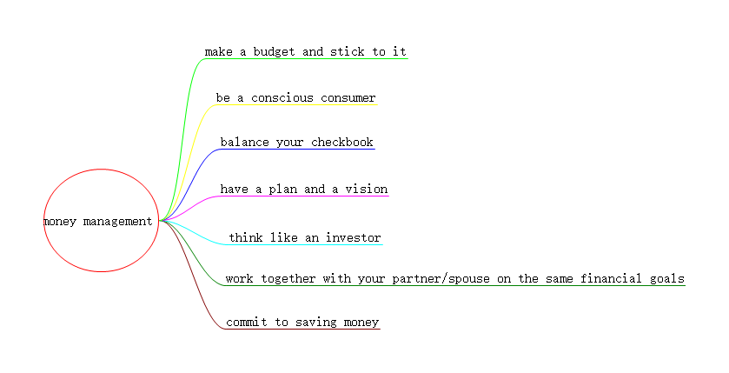
Theme exploration

Slide 20
Checklist
We’ve learnt:
words & phrases:
√
propose, exchange, involve, show off, no longer…
how to manage money
√

Slide 21
Assignments
01
1. Review the vocabularies and difficult sentences.
2. Learn more money management skills .
3. Try to retell the text.

Slide 22
Thank you

